Slide 1

Critical Thinking and Problem Solving in Digital Professions week 3

Slide 2
Lesson outlines
Analyze problem-solving techniques applicable to digital environments.
Apply critical thinking to case studies involving real-world digital issues.
Understand and utilize Bloom’s Taxonomy and the Kepner-Tregoe Decision-Making Model in problem-solving.

Slide 3

critical thinking
noun
1: the act or practice of thinking critically (as by applying reason and questioning assumptions) in order to solve problems, evaluate information, discern biases, etc.

Slide 4
why critical thinking is important in the digital workplace?

Slide 5
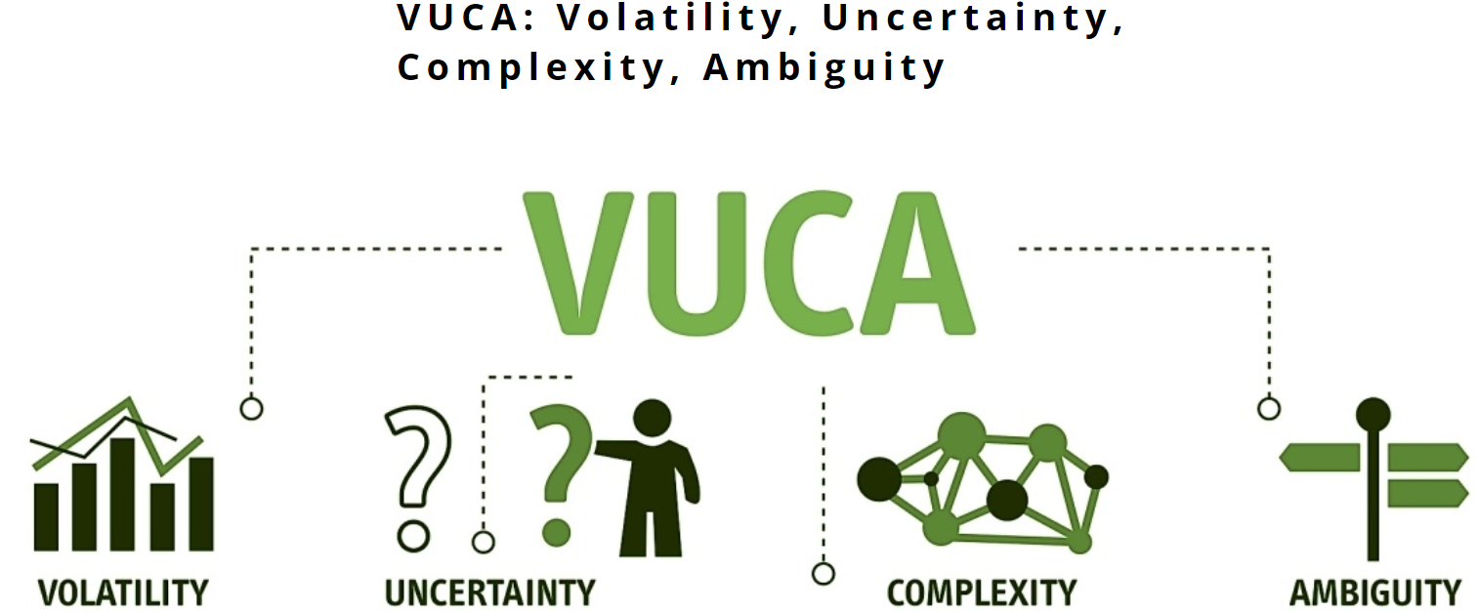
https://tech4future.info/en/vuca/

Slide 6
“Change is not always equivalent to improvement, but to improve, one must change”
(Winston Churchill)
V
The classic example of volatility in markets and business remains the continuous fluctuation of the price of oil
U
When one cannot understand the change taking place or cannot make predictions about what a given event or change will entail, one is in an uncertainty context
C
Complexity is characteristic of those events or environments in which the variables at play are so numerous and interrelated that they give rise to an intricate and heterogeneous network that is difficult to decipher and analyse
A
In a context of ambiguity, it is difficult to come to conclusions and have a clear view of things
(Boldrini, 2024)

Slide 7
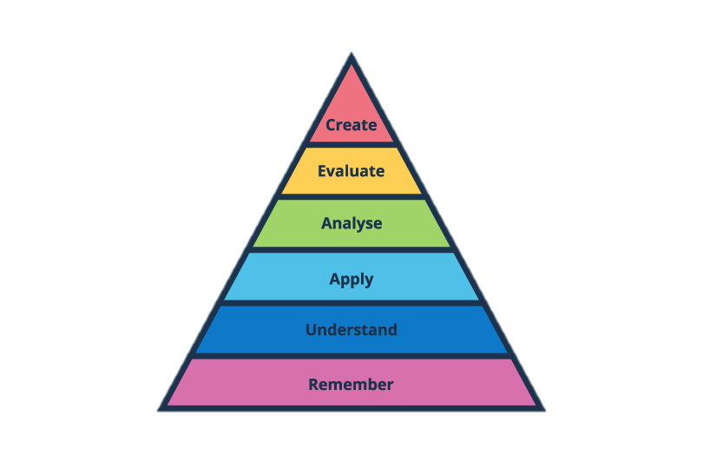
Bloom’s Taxonomy
In 1956, Benjamin Bloom with his collaborators published a framework for categorizing educational goals: Taxonomy of Educational Objectives. Familiarly known as Bloom’s Taxonomy, this framework has been applied by generations of K-12 teachers and college instructors in their teaching.
Origin
A Taxonomy for Teaching, Learning, and Assessment
A group of cognitive psychologists, curriculum theorists and instructional researchers, and testing and assessment specialists published in 2001 a revision of Bloom’s Taxonomy
https://blog.teamsatchel.com/hs-fs/hubfs/Blooms%20Taxonomy%20with%20labels%20(2).png?width=810&height=540&name=Blooms%20Taxonomy%20with%20labels%20(2).png

Slide 8
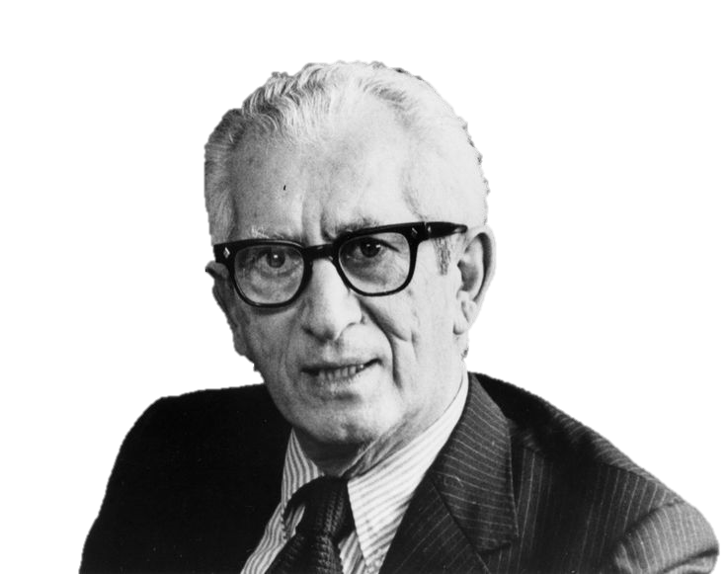
Bloom’s Taxonomy
Remember
https://ar.pinterest.com/pin/1148277236224865977/
Recognizing
Recalling
Create
Understand
Generating
Planning
Producing
Interpreting
Exemplifying
Classifying
Summarizing
Inferring
Comparing
Explaining
Evaluate
Checking
Critiquing
Apply
Analyze
Executing
Implementing
Differentiating
Organizing
Attributing
give examples of applying each level to digital workplace scenarios

Slide 9
Kepner-Tregoe Decision-Making Model
It’s a structured methodology, developed by Charles Kepner and Benjamin Tregoe, that guides you through a structured process for making complex decisions. It’s not about magic formulas or gut feelings. Instead, it relies on logic, data, and a step-by-step approach to help you:
Clearly define your goal: What are you trying to achieve?
Identify your must-haves: What are the non-negotiables?
Explore your options: What are the different paths you can take?
Weigh the pros and cons: What are the risks and rewards of each option?
Make an informed choice: Choose the option that best fits your goals and limitations.
(Chandra, 2024)

Slide 10
Kepner-Tregoe Decision-Making Model
The Kepner-Tregoe (KT) model is a structured approach for making decisions and solving problems:
Situation appraisal: Clarify the situation and define the problem's scope and urgency.
Problem analysis: Identify the root cause of the problem.
Decision analysis: Evaluate potential solutions and select the best one.
Potential problem analysis: Assess the risks associated with the chosen solution and develop emergency plans.

Slide 11
Group Discussion for a Case Study
Case Study: Handling a Cybersecurity Breach in a Digital Workplace

Slide 12
REFERENCE LIST and ADDITIONAL READING
Boldrini, N. (2024) Vuca: Volatility, uncertainty, complexity, ambiguity, Tech4Future. Available at: https://tech4future.info/en/vuca/ (Accessed: 11 October 2024).
Critical thinking definition & meaning (no date) Merriam-Webster. Available at: https://www.merriam-webster.com/dictionary/critical%20thinking (Accessed: 11 October 2024).
Mcdaniel, R. (1970) Bloom’s taxonomy, Vanderbilt University. Available at: https://cft.vanderbilt.edu/guides-sub-pages/blooms-taxonomy/#:~:text=Familiarly%20known%20as%20Bloom’s%20Taxonomy,Analysis%2C%20Synthesis%2C%20and%20Evaluation. (Accessed: 11 October 2024).
Chandra, D. (2024) How to make decisions using the Kepner Tregoe decision analysis, The Process Hacker. Available at: https://theprocesshacker.com/blog/kepner-tregoe-decision-analysis/ (Accessed: 12 October 2024).

Slide 13
THANK YOU!

